Slide 1
Electromagnetic Waves
9th October 2018

Slide 2
Maxwell’s Equations, General Set
Point Form | Integral Form
Notes:
E = electric field (V/m)
H = magnetic field (A/m)
B = magnetic flux density (Wb/m^2)
D = electric flux density (C/m^2)
J = current density (A/m^2)
= volume charge density (c/m^3)

Slide 3
Significance of the Maxwell’s equations
The two time-varying equations are mathematically sufficient to produce separate wave equations for the electric and magnetic field vectors.
Also, they indicates time variable E and H fields cannot exist independently.
The steady state equations help to identify the wave nature as transverse.
Two constitutive equations are needed for solving the Maxwell’s equations.
Notes:
= permittivity : the measure of the resistance that is encountered when forming an electric field in the medium
μ = permeability : the degree of magnetization of a material in response to a magnetic field. Or the measure of the ability of material to support the forming of a magnetid field within itself.

Slide 4
Scopes of study
Electromagnetic waves in a medium having finite permeability μ and permittivity ε but with conductivity σ = 0,
The wave equation for electromagnetic Waves in a dielectric,
Impedance of a dielectric to electromagnetic Waves,
Electromagnetic waves in a medium of properties μ, ε and σ (where σ ≠ 0 ),
Electromagnetic wave velocity in a conductor and anomalous dispersion,

Slide 5
Electromagnetic waves in a medium having finite permeability μ and permittivity ε but with conductivity σ = 0
Given conditions
The properties of the chosen plane waves in xy plane are constant,
These properties will not vary with respect to x and y and all derivatives ∂/∂x and ∂/∂y will be zero.
In dielectric, no charge (ρ = 0) and no current density (J = 0).
Notes:
The main properties of wave include amplitude, phase, frequency, wavelength and speed.

Slide 6
Maxwell’s equations in dielectric
(1A)
(2A)
(3A)
(4A)

Slide 7
The wave equation for electromagnetic Waves in dielectric
Since, with these plane waves, all derivatives with respect to x and y are zero. Equations (2A) and (4A) give
This implies that H_{z} is constant in space and time.
H_{z} has no effect on the wave motion. For simplicity, put H_{z} = 0.
A similar consideration of equations (1A) and (3A) leads to E_{z} = 0.
The above results suggest that the oscillations in H an E occur in direction perpendicular to z-direction. In other words, the EM plane wave is transverse.

Slide 8
The wave equation for electromagnetic Waves in dielectric : plane-polarized waves (1)
Consider E_{x} only, with E_{y} = 0, equations (3A) and (4A) give
Using the fact that
The wave equation for H_{y} is found to be
Similarly, the wave equation for E_{x} is
Notes:
The plane wave is said to be linearly polarized because the electric vector is always along the x axis and similarly, the magnetic vector is always along the y axis.

Slide 9
Recall a formal derivation of the wave equation from Maxwell’s equations in dielectric (1)
From identity
From the constitutive equation :
Due to equation (1) :
From equation (3) :
From the constitutive equation :
From equation (4) and constitutive equation :

Slide 10
Recall a formal derivation of the wave equation from Maxwell’s equations in dielectric (2)
The wave equation
Possible solution for the wave equation may be given as
By substituting the solution in the wave equation, we obtain
Finally, the wave equation in free space becomes

Slide 11
The wave equation for electromagnetic Waves in dielectric : plane-polarized waves (2)
The vector E_{x} and H_{y} obey the same wave equation.
In free space, the velocity is that of light given as
Solutions of the wave equations
The vector product gives direction of the energy flow. This can be seen from the product dimension:
H_{y}
Notes:
The solutions represent the EM wave propagates in the z direction.

Slide 12
Plane electromagnetic waves
(a) The electric field E, magnetic field B and propagation vector k are everywhere mutually perpendicular
(b) Wavefronts for a linear polarized plane electromagnetic wave
F Pedrotti et. al. “Introduction to optics”, 3ed., Pearson international ( 2007)

Slide 13
Energy density of electromagnetic wave in free space
An electromagnetic wave represents the transmission of enegry.
The energy density, in J/m³ , for electric field u_{E} and magnetic field u_{B} in free space are given as
At any specified time and place, the two field are related by E = cB .
This gives u_{E} = u_{B} and the total energy density is u = u_{E} + u_{B} = 2u_{E} = 2u_{B}
Or

Slide 14
Poynting vector (1)
Consider the power or the rate at which energy is transported by the electromagnetic wave.
Energy flow of an EM wave in time Δt. The energy enclosed in the rectangular volume ΔV flows across the surface A..
Therefore, power transferred per unit area S is

Slide 15
Poynting vector (2)
The power per unit area in terms of E and B is given as
The power unit area, S, when assigned the direction of propagation, is called Poynting vector. This can be written as
Time average of the power per unit area called irradiance is given as
Notes:
I = the time average of the magnitude of the poyntin vector

Slide 16
Problem : Poynting vector (energy flow in w/m²)
The plane polarized electromagnetic wave (E_{x}, H_{y}) travels in free space.
Show that its Poynting vector is given by
Where c is the velocity of light.
Determine the intensity in such a wave.

Slide 17
Solution
Due to and the constitutive equation
The Poynting vector becomes
With appropriate solution for the plane wave;
This gives
Using equation (3) from page 6, this leads to
Therefore,
Notes:
Equation (3) from page 6

Slide 18
Solution
The intensity of this wave can be calculated from

Slide 19
Problem : average irradiance
A laser beam of radius 1 mm carries a power of 6 kW.
Determine its average irradiance and the amplitude of its E and B fields.

Slide 20
Solution
The average irradiance can be found from power/area = 1.91 x 10⁹ W/m²
From the irradiance , the amplitude of E field is found to be 1.20 x 10⁶ V/m
Due to the relationship E = cB, the amplitude of B field becomes 4.00 x 10⁻³ T

Slide 21
Impedance of a dielectric to electromagnetic Waves
From the
If the medium is free space and
Also the dimensions of is ohms (check this!)
Therefore, represents the free space characteristic impedance
to electro magnetic wave travelling through it.
Notes:
Si base unit of voltage = kg m^2/A s^3

Slide 22
Electromagnetic waves in a medium of properties μ, ε and σ (where σ ≠ 0 ) (1)
To derive the wave equation of the plane polarized wave composed E_{x} and H_{y} components propagating in a conductor, let’s start with equation (4) from page 6 with a current density term
This becomes
Taking ∂/∂t,

Slide 23
Electromagnetic waves in a medium of properties μ, ε and σ (where σ ≠ 0 ) (2)
Also consider equation (3) from page 6 :
This gives
Taking ∂/∂z,
The final equation as the wave equation for EM waves in a conductor is found to be
Diffusion term

Slide 24
Electromagnetic wave in a conductor
Recall the wave equation of EM plane polarized wave in a conductor,
A solution of the wave equation is found to be
Where

Slide 25
Solution of the wave equation with diffusion effect
Recall, the wave equation in a conductor,
With the assumption that its time-variation is simple harmonic,
Substitute the assumed solution into the wave equation,

Slide 26
Solution of the above 2nd order differential equation is given as
Since the wave propagates in +z direction the second term of the solution is chosen.
This gives the final solution for the wave equation in a conductor as follows,

Slide 27
The ratio of the current density terms can be written as
For a conductor, where , then
This can be written as
The wave function becomes
Exponential decay term for the amplitude
Notes:
A conduction current flows in a good conductor, e.g., a metal. The current then consists of free electrons which are the charge carriers. Its strength is determined by the electrical conductivity of the material through which the current flows. The displacement current can exist in all materials, whether conducting or non-conducting. Consider a non-conducting material like wood or glass, placed in an electric field. There are no free electrons in glass and so conduction current does not exist. However, the electric field leads to some realignment of charges inside the material. Electrons, though bound to the atoms, are displaced slightly opposite to the direction of the electric field. The material thus gets polarized. If the electric field is switched off, the electrons go back to their original configurations. If the electric field changes direction repeatedly, the electrons move slightly to and fro inside the material with the changing electric field. This slight movement of electrons constitutes the displacement current. Its strength depends on the frequency with which the electric field changes. The existence of displacement current was theoretically proposed by Maxwell and is incorporated in his equations of electromagenetis
https://www.quora.com/What-are-the-differences-between-conduction-current-and-displacement-current

Slide 28
Skin depth
The skin depth is the travelling distance of EM wave in the conductor when the electric field vector has decayed to a value of E_{x} = E₀e⁻¹.
This explains the electrical shielding properties of a conductor, λ_{c} is the wavelength in the conductor.

Slide 29
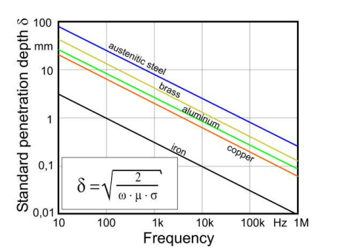
Example of skin depth for metals
https://www.ndt.net/article/ecndt2006/doc/Tu.3.6.2.pdf
Notes:
Austenitic steel เหล็กหล้าไร้สนิม

Slide 30
Electromagnetic wave velocity in a conductor and anomalous dispersion
Recall the wave function in a conductor
The phase velocity of the wave v is given by
Since the phase velocity is a function of the frequency, an electrical conductor is dispersive medium to EM waves.
Because ∂v/∂λ is negative so that the conductor is anomalously dispersive and the group velocity is greater than the phase velocity.
Notes:
https://www.quora.com/What-are-the-differences-between-conduction-current-and-displacement-current

Slide 31
High frequency EM waves propagate only a very small distance in conductor.
When δ is small, the phase velocity v is small, and the refractive index c/v of a conductor can be very large. This results in the high optical reflectivity.
Determine the distance in which the amplitude of the striking EM wave drops to about 1% of its surface value.
Notes:
4.6δ = 3/4λc

Slide 32
http://ecee.colorado.edu/~ecen3400/Chapter%2020%20-%20The%20Skin%20Effect.pdf
Notes:
Skin effect is the tendency of an alternating electric current (AC) to become distributed within a conductor such that the current density is largest near the surface of the conductor, and decreases with greater depths in the conductor. The electric current flows mainly at the "skin" of the conductor, between the outer surface and a level called the skin depth. The skin effect causes the effective resistance of the conductor to increase at higher frequencies where the skin depth is smaller, thus reducing the effective cross-section of the conductor. The skin effect is due to opposing eddy currents induced by the changing magnetic field resulting from the alternating current. At 60 Hz in copper, the skin depth is about 8.5 mm. At high frequencies the skin depth becomes much smaller. Increased AC resistance due to the skin effect can be mitigated by using specially woven litz wire. Because the interior of a large conductor carries so little of the current, tubular conductors such as pipe can be used to save weight and cost

Slide 33
When is a medium a conductor or a dielectric?
The ratio of the current density is used to determine whether the medium is a conductor or a dielectric.
The conduction current dominates and the medium is a conductor :
The displacement current dominates and the material behaves as a dielectric :
Notes:
ในกรณีของ dielectric อาจมองในรูป σ/ωε < 10^-2

Slide 34
Typically, an insulator has σ ≈ 10⁻¹⁵ S m⁻¹ and ε ≈ 10⁻¹¹ F m⁻¹, which gives
So the conduction current is negligible at all frequencies.

Slide 35
Notes:
λ≈ 3 m

Slide 36
Impedance of a conduction medium to EM waves
Recall the electric field in a conductor
The corresponding magnetic filed in the conductor is given as
Given that
The impedance of the conductor is given as
By using time-dependent Maxwell’s equation

Slide 37
The magnitude of Z_{C}
Recall the impedance of a conducting medium,
The magnitude can be written in terms of the free space impedance as follows,

Slide 38
Reflection and transmission of EM waves at a boundary : Normal incidence
The boundary conditions, from EM theory, are that the components of the field vectors E and H tangential or parallel to the boundary are continuous across the boundary.

Slide 39
Reflection and transmission coefficients : normal incidence
What happens to the travelling wave normally striking a perfect conductor in terms of reflection and transmission coefficients?
Due to Z₂ = 0
Notes:
A perfect conductor possesses a value of impedance = 0.
Thus good conductors are very good reflectors of EM waves.

Slide 40
Oblique incidence and Fresnel’s Equations for dielectrics
The same boundary conditions are still applied.
Two cases have to be investigated :
H perpendicular to the plane of incidence and
E perpendicular to the plane of incidence
Verify the direction of H_{i} in the figure.

Slide 41
Reflection and transmission coefficients : oblique incidence
For H perpendicular to the plane of incidence
For E perpendicular to the plane of incidence

Slide 42
Reflection and transmission coefficients in terms of refractive index n
Since
The reflection and transmission coefficients can be expressed in terms of refractive indices of incident (n₁) and transmitted (n₂)media.

Slide 43
Fresnel’s equations
What are the reflection coefficients at the normal incidence in terms of refractive indices?

Slide 44
Brewster angle or polarizing angle θ_{B} can be found from

Slide 45
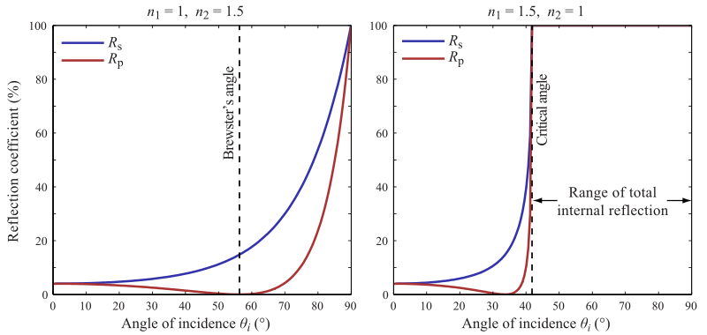
External and internal reflections at air-glass interface
x100
∼4%
https://en.wikipedia.org/wiki/Fresnel_equations

Slide 46
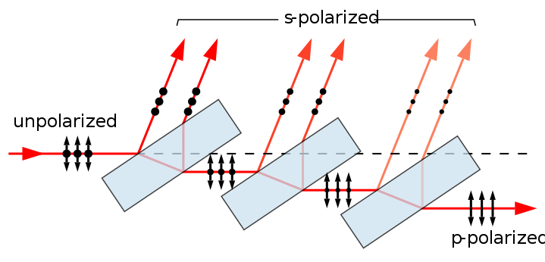
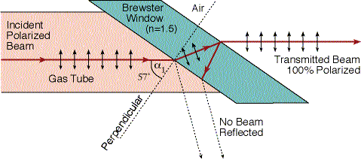
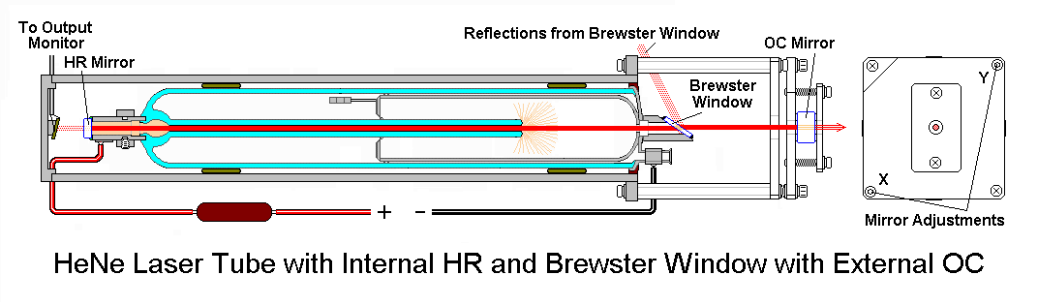
Application of Brewster angle
A stack of plates at Brewster's angle to a beam reflects off a fraction of the s-polarized light at each surface, leaving a p-polarized beam. Full polarization at Brewster's angle requires many more plates than shown. The arrows indicate the direction of the electrical field, not the magnetic field, which is perpendicular to the electric field.
https://en.wikipedia.org/wiki/Polarizer
S or P linear state of the output laser beam?
https://commons.wikimedia.org/wiki/File:Brewster-polarizer.svg
https://perg.phys.ksu.edu/vqm/laserweb/Ch-7/F7s5t1p6.htm
https://www.tau.ac.il/~phchlab/experiments_new/SemB04_Sucrose/02TheoreticalBackground.html

Slide 47
Reflection from a conductor
(Normal incidence)
The refractive index of a conduction medium is given as
where
The ratio E_{r}/E_{i} is therefore complex and the value of reflected intensity I_{r} is found from

Slide 48
Example metal reflected intensity at IR
For copper σ = 6 x 10⁷ (ohm m⁻¹) and (2ωε₀/σ)^{1/2} ≈ 0.01 at infer-red frequencies. Determine the metal reflected intensity at the IR range.
Notes:
≈98%

